Slide 1

APPLICATIONS OF ARTIFICIAL INTELLIGENCE FOR CYBER SECURITY GROUP PROJECT
MEMBERS:
MUHAMMAD NURFAJRI 45786305
FAISAL RAHMAN 46261745
SADIA NOWSHIN 46295925
June 5, 2022

Slide 2

THE CODE SOLVER
FAISAL RAHMAN
MALWARE DETECTION
MUHAMMAD NURFAJRI
PROBING DETECTION
SADIA NOWSHIN
NETWORK INTRUSION DETECTION

Slide 3
MALWARE DETECTION
The Steps Involved:
Data Collection
Iterating through each json file
extracting files inside properties field
Concatenating into one dataframe
Data Preprocessing
Checking the dataset characteristic
Checking any Null, NaN, or Empty Values
Filtering with a threshold value
Subsampling dataset.
Training The Model
Decision Tree Classifier
KNN Classifier
Result Comparison
Decision Tree Accuracy
KNN Accuracy

Slide 4
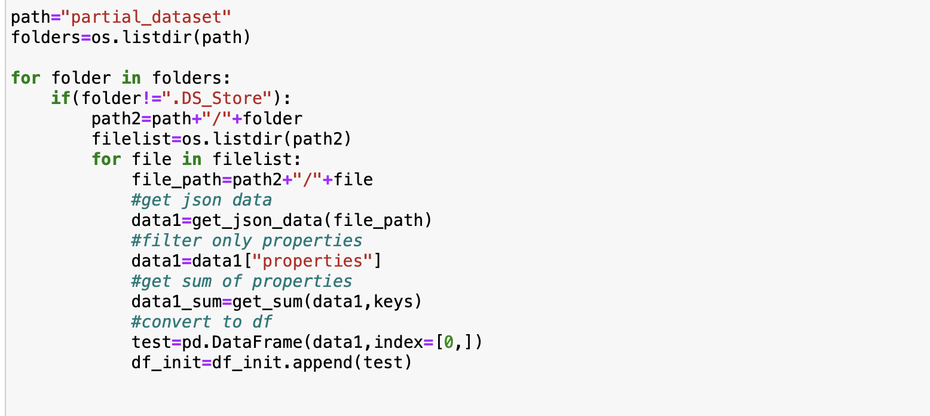
MALWARE DETECTION
The Steps Involved:
Data Collection
Iterating through each json file
extracting files inside properties field
Concatenating into one dataframe
Data Preprocessing
Checking the dataset characteristic
Checking any Null, NaN, or Empty Values
Filtering with a threshold value
Subsampling dataset.
Training The Model
Decision Tree Classifier
KNN Classifier
Result Comparison
Decision Tree Accuracy
KNN Accuracy

Slide 5
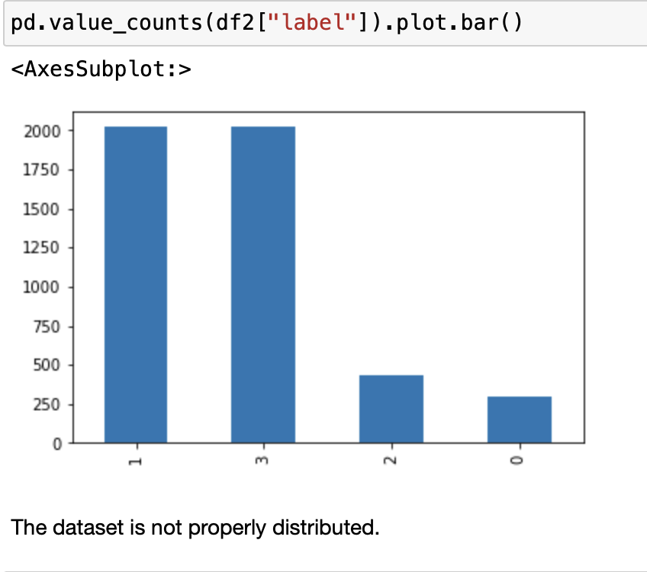
MALWARE DETECTION
The Steps Involved:
Data Collection
Iterating through each json file
extracting files inside properties field
Concatenating into one dataframe
Data Preprocessing
Checking the dataset characteristic
Checking any Null, NaN, or Empty Values
Filtering with a threshold value
Subsampling dataset.
Training The Model
Decision Tree Classifier
KNN Classifier
Result Comparison
Decision Tree Accuracy
KNN Accuracy

Slide 6
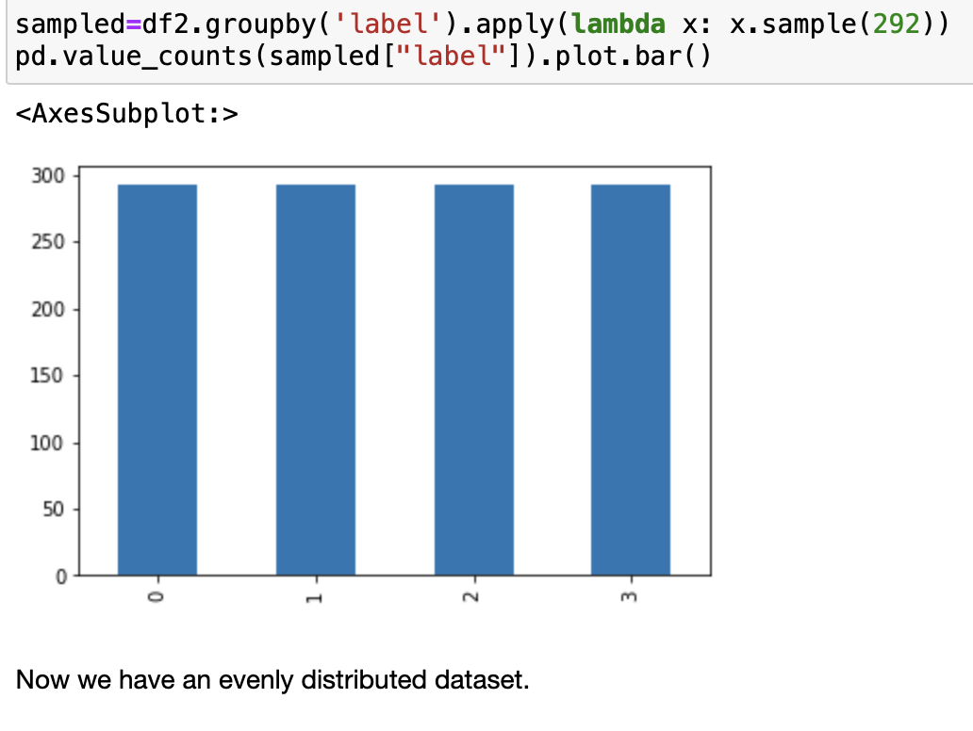
MALWARE DETECTION
The Steps Involved:
Data Collection
Iterating through each json file
extracting files inside properties field
Concatenating into one dataframe
Data Preprocessing
Checking the dataset characteristic
Checking any Null, NaN, or Empty Values
Filtering with a threshold value
Subsampling dataset.
Training The Model
Decision Tree Classifier
KNN Classifier
Result Comparison
Decision Tree Accuracy
KNN Accuracy

Slide 7
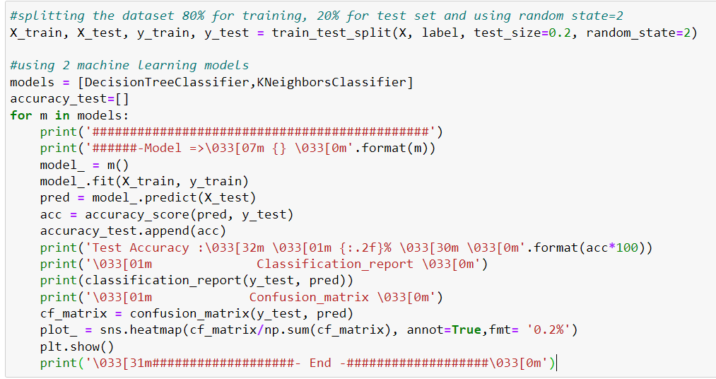
MALWARE DETECTION
The Steps Involved:
Data Collection
Iterating through each json file
extracting files inside properties field
Concatenating into one dataframe
Data Preprocessing
Checking the dataset characteristic
Checking any Null, NaN, or Empty Values
Filtering with a threshold value
Subsampling dataset.
Training The Model
Decision Tree Classifier
KNN Classifier
Result Comparison
Decision Tree Accuracy
KNN Accuracy

Slide 8
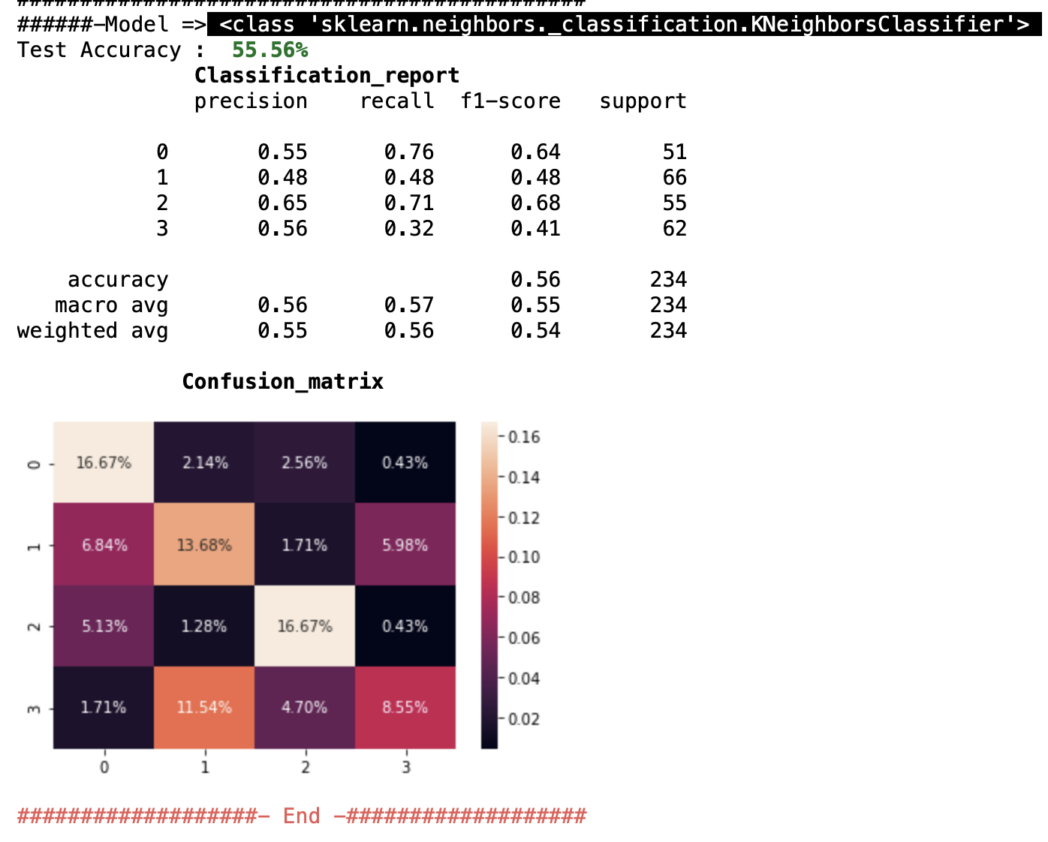
MALWARE DETECTION
The Steps Involved:
Data Collection
Iterating through each json file
extracting files inside properties field
Concatenating into one dataframe
Data Preprocessing
Checking the dataset characteristic
Checking any Null, NaN, or Empty Values
Filtering with a threshold value
Subsampling dataset.
Training The Model
Decision Tree Classifier
KNN Classifier
Result Comparison
Decision Tree Accuracy
KNN Accuracy

Slide 9
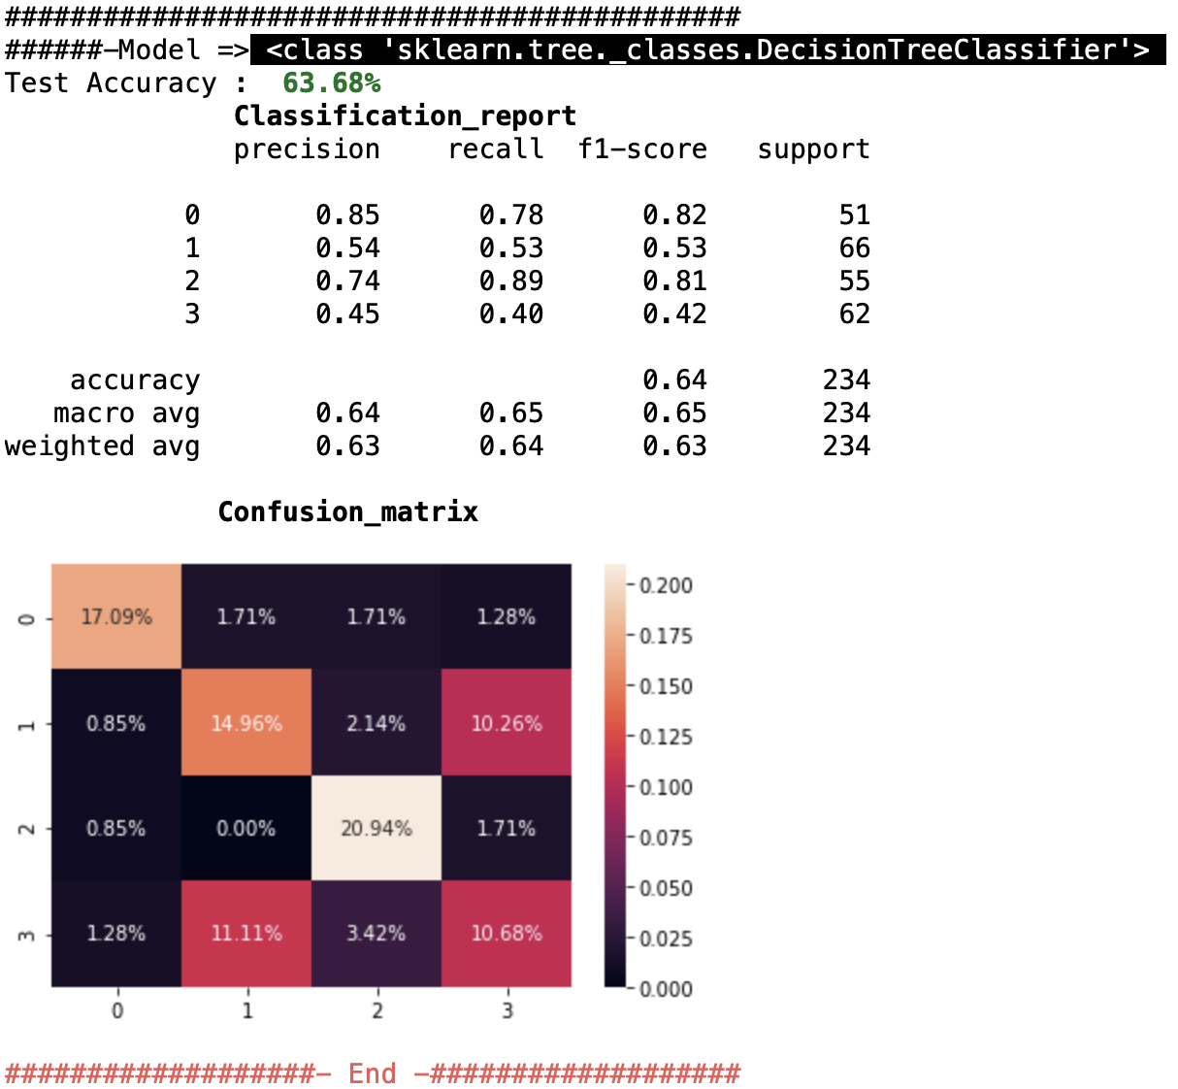
MALWARE DETECTION
The Steps Involved:
Data Collection
Iterating through each json file
extracting files inside properties field
Concatenating into one dataframe
Data Preprocessing
Checking the dataset characteristic
Checking any Null, NaN, or Empty Values
Filtering with a threshold value
Subsampling dataset.
Training The Model
Decision Tree Classifier
KNN Classifier
Result Comparison
Decision Tree Accuracy
KNN Accuracy

Slide 10
PROBING DETECTION
The Steps Involved:
Data Preprocessing
Checking the dataset characteristic
Checking any Null, NaN, or Empty Values
Convert to Hex
Convert to Integer
Training The Model
Decision Tree Classifier
KNN Classifier
Result Comparison
Decision Tree Accuracy
KNN Accuracy

Slide 11
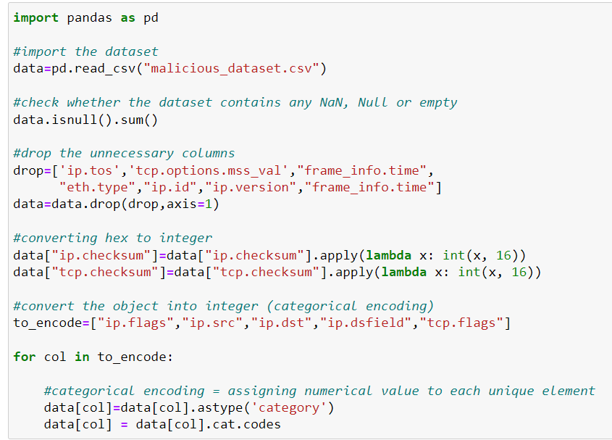
PROBING DETECTION
The Step Involved:
Data Preprocessing
Checking the dataset characteristic
Checking any Null, NaN, or
Empty Values
Convert to Hex
Convert to Integer
Training The Model
Decision Tree Classifier
KNN Classifier
Result Comparison
Decision Tree Accuracy
KNN Accuracy

Slide 12
PROBING DETECTION
The Step Involved:
Data Preprocessing
Checking the dataset characteristic
Checking any Null, NaN, or
Empty Values
Convert to Hex
Convert to Integer
Training The Model
Decision Tree Classifier
KNN Classifier
Result Comparison
Decision Tree Accuracy
KNN Accuracy

Slide 13
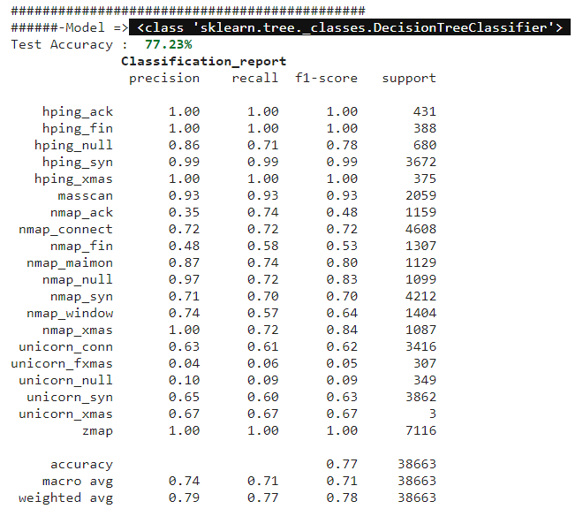
PROBING DETECTION
The Step Involved:
Data Preprocessing
Checking the dataset characteristic
Checking any Null, NaN, or
Empty Values
Convert to Hex
Convert to Integer
Training The Model
Decision Tree Classifier
KNN Classifier
Result Comparison
Decision Tree Accuracy
KNN Accuracy

Slide 14
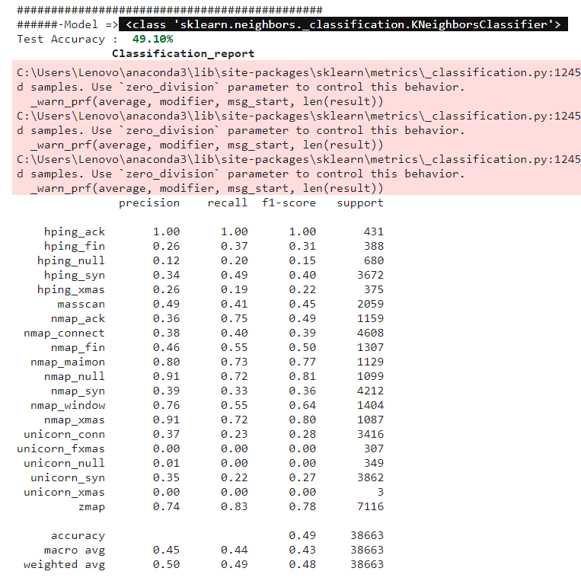
PROBING DETECTION
The Step Involved:
Data Preprocessing
Checking the dataset characteristic
Checking any Null, NaN, or
Empty Values
Convert to Hex
Convert to Integer
Training The Model
Decision Tree Classifier
KNN Classifier
Result Comparison
Decision Tree Accuracy
KNN Accuracy

Slide 15
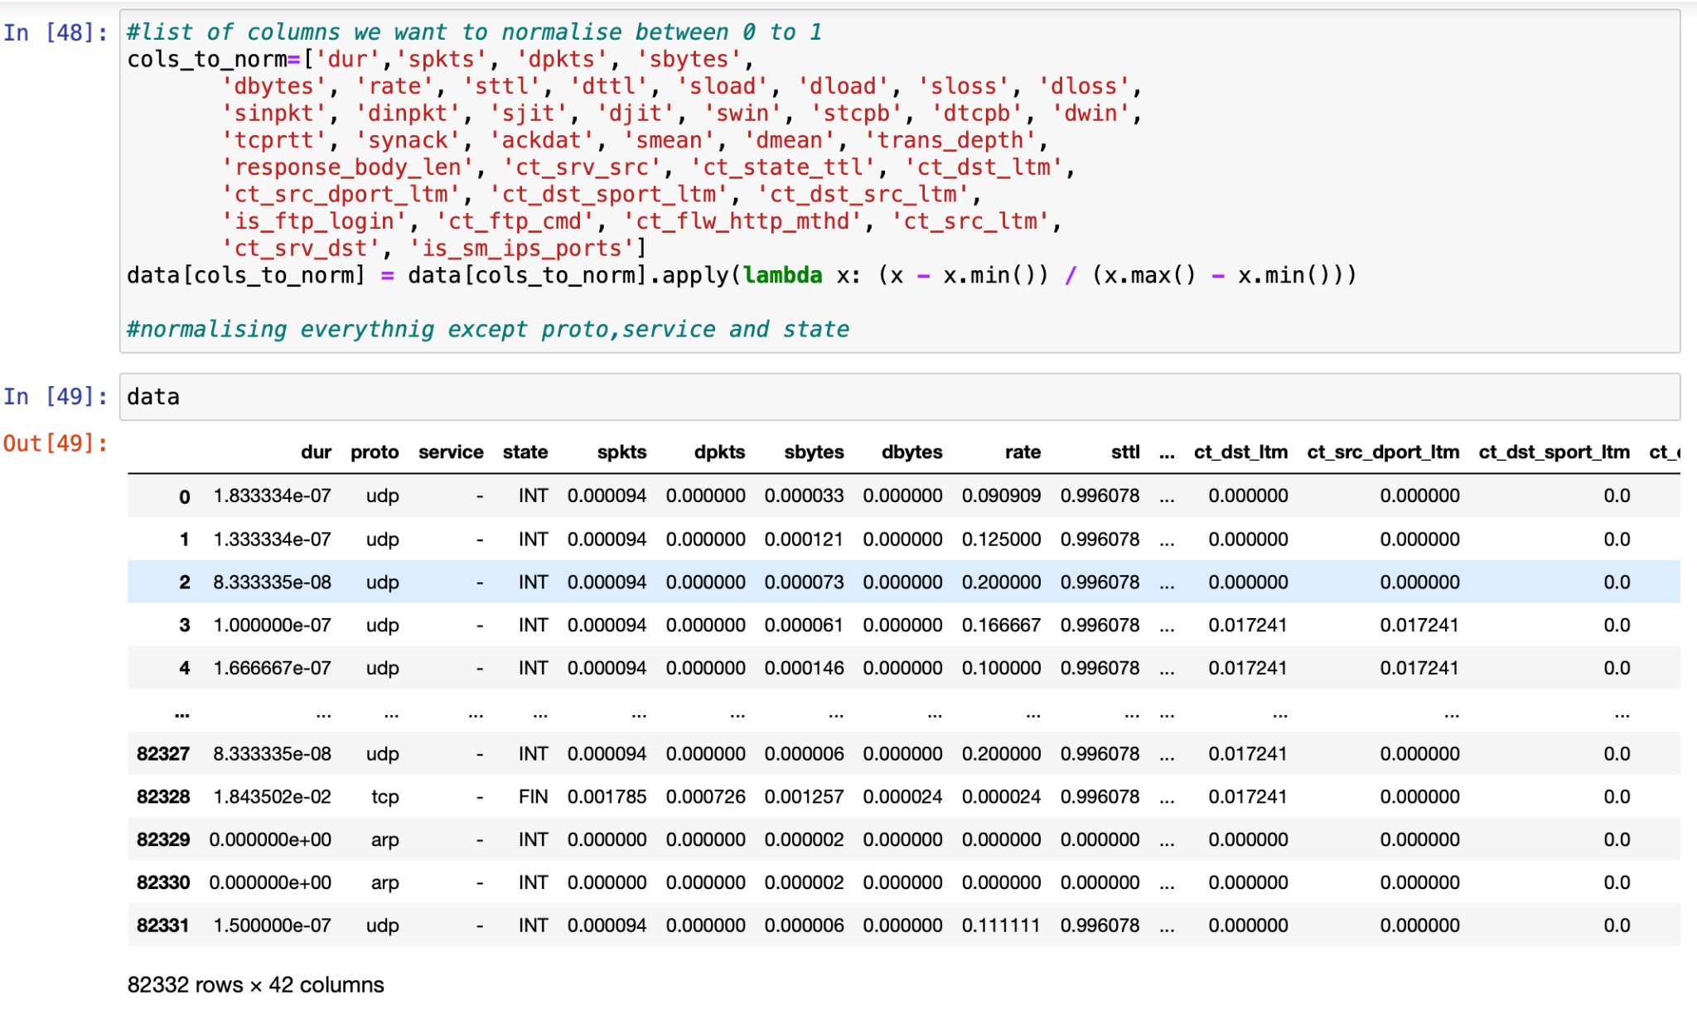
NETWORK INTRUSION DETECTION
The Steps Involved:
Data Preprocessing
Checking the dataset characteristic
Checking any Null, NaN, or Empty Values
Normalising dataset
Encoding unique column elements.
Training The Model
Decision Tree Classifier
KNN Classifier
Result Comparison
Decision Tree Accuracy
KNN Accuracy

Slide 16
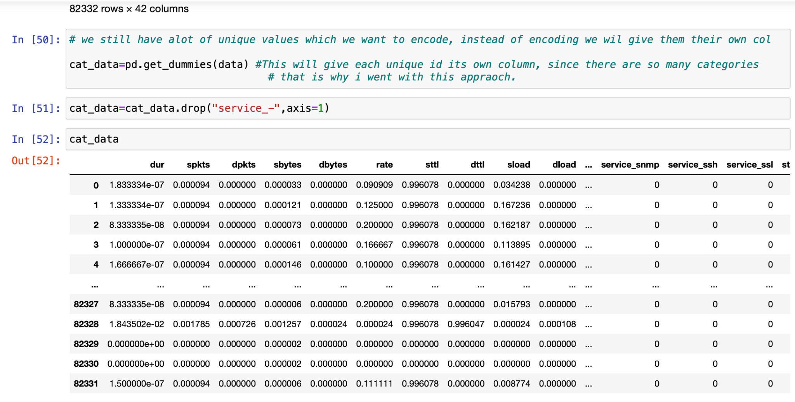
NETWORK INTRUSION DETECTION
The Steps Involved:
Data Preprocessing
Checking the dataset characteristic
Checking any Null, NaN, or Empty Values
Normalising dataset
Encoding unique column elements.
Training The Model
Decision Tree Classifier
KNN Classifier
Result Comparison
Decision Tree Accuracy
KNN Accuracy

Slide 17
NETWORK INTRUSION DETECTION
The Steps Involved:
Data Preprocessing
Checking the dataset characteristic
Checking any Null, NaN, or Empty Values
Normalising dataset
Encoding unique column elements.
Training The Model
Decision Tree Classifier
KNN Classifier
Result Comparison
Decision Tree Accuracy
KNN Accuracy

Slide 18
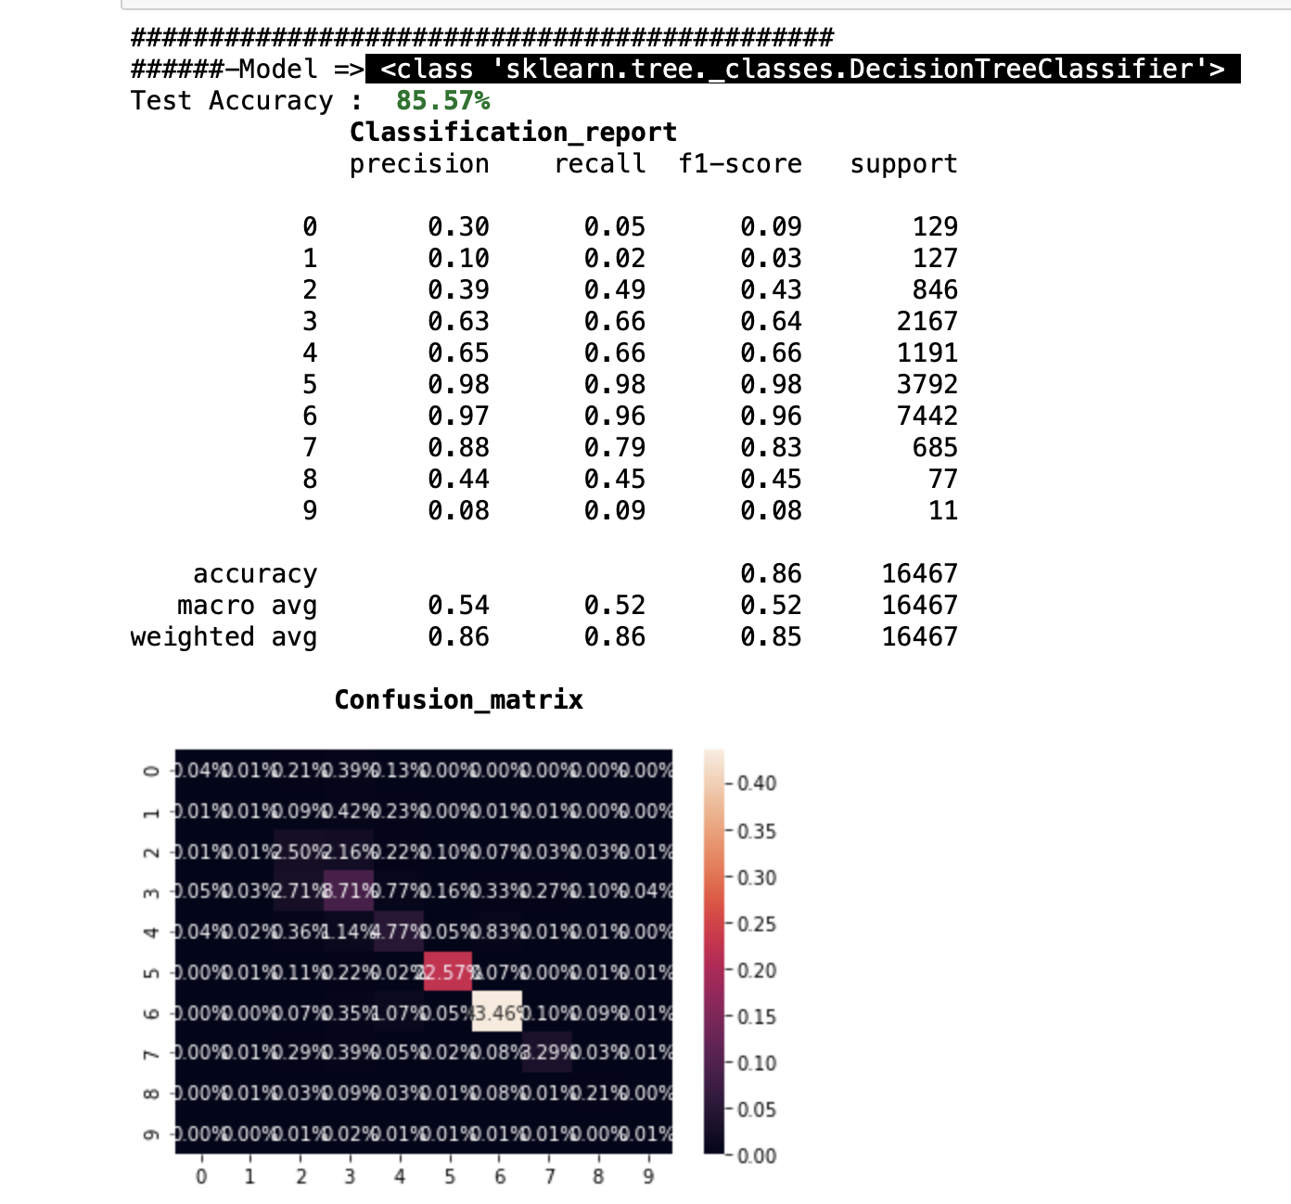
NETWORK INTRUSION DETECTION
The Steps Involved:
Data Preprocessing
Checking the dataset characteristic
Checking any Null, NaN, or Empty Values
Normalising dataset
Encoding unique column elements.
Training The Model
Decision Tree Classifier
KNN Classifier
Result Comparison
Decision Tree Accuracy
KNN Accuracy

Slide 19
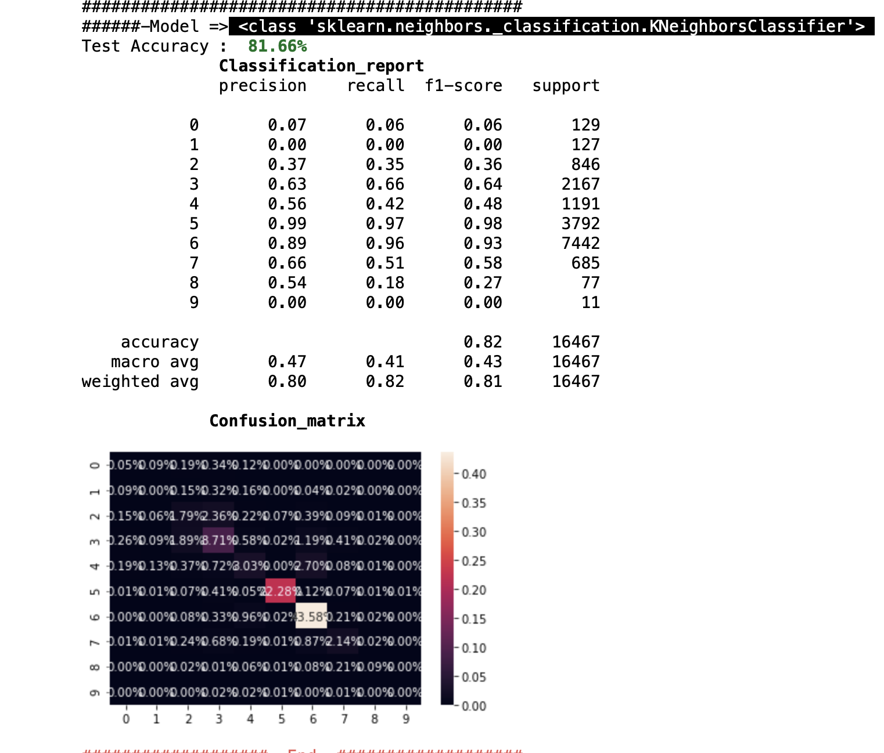
NETWORK INTRUSION DETECTION
The Steps Involved:
Data Preprocessing
Checking the dataset characteristic
Checking any Null, NaN, or Empty Values
Normalising dataset
Encoding unique column elements.
Training The Model
Decision Tree Classifier
KNN Classifier
Result Comparison
Decision Tree Accuracy
KNN Accuracy

Slide 20


THANK YOU
MUHAMMAD NURFAJRI
FAISAL RAHMAN
SADIA NOWSHIN
SCAREDBUNNY TEAM

